Slide 1
NRM & Landcare in SA
Collaboration: people & landscapes
Kym Good, Regional Manager
Natural Resources, Adelaide and Mount Lofty Ranges
Department of Environment, Water and Natural Resources

Slide 2
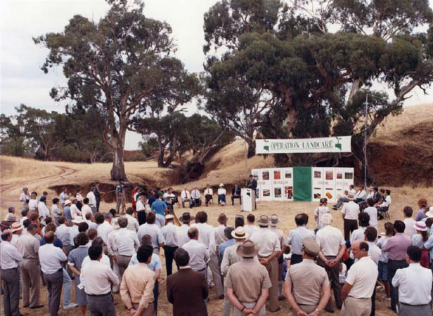
Landcare and NRM: A brief history
Launch of the Year of Landcare, Cobblers Creek 1989
Notes:
Decade of Landcare
Over 300 groups across SA
NRM Act 2004

Slide 3
Key dates in Landcare and NRM
1986: Animal Plant and Protection Act; National Environment Protection Act
1990: Decade of Landcare begins; Soil Conservation Council established
2015: LASA and NRM MoC
1991: Native Vegetation Act
1993: State Environment Protection Act
1995: Catchment Water Management Act
2001: Natural Heritage Trust
2004: NRM Act; 8 Regional NRM boards est.
1989: Soil Conservation and Land Care Act; Tungkillo LG and Inman Valley Torrensvale LG est.
2006: State NRM Plan
2008: Caring for Our Country
2010: DENR and NRM Board amalgamation
1986
1990
1993
1995
2001
2004
2006
2008
2010
2015
1989
1991
Notes:
Previously:
1939: Soil Conservation Act
1940 – 1990: Advisory Committee on Soil Conservation, with establishment of soil conservation districts beginning in 1947 in the Upper EP.
February 1989: In AMLR, Tungkillo LG and Inman Valley Torrensvale LG established – first groups in region
Some groups were working alongside well established ag bureaus or farming groups. Some operating as tree-planting/reveg focused groups and some more focused on sustainable agriculture.
Post NRM: Introduction of NRM caused a number of groups to dissolve due to reduced funding and resulted in many groups and group members feeling disenfranchised – the ownership and understanding of Landcare that had built up through the 90s was lost. Weakened community network, and weakened connection with government after removal of local soil conservation boards and catchment boards.

Slide 4
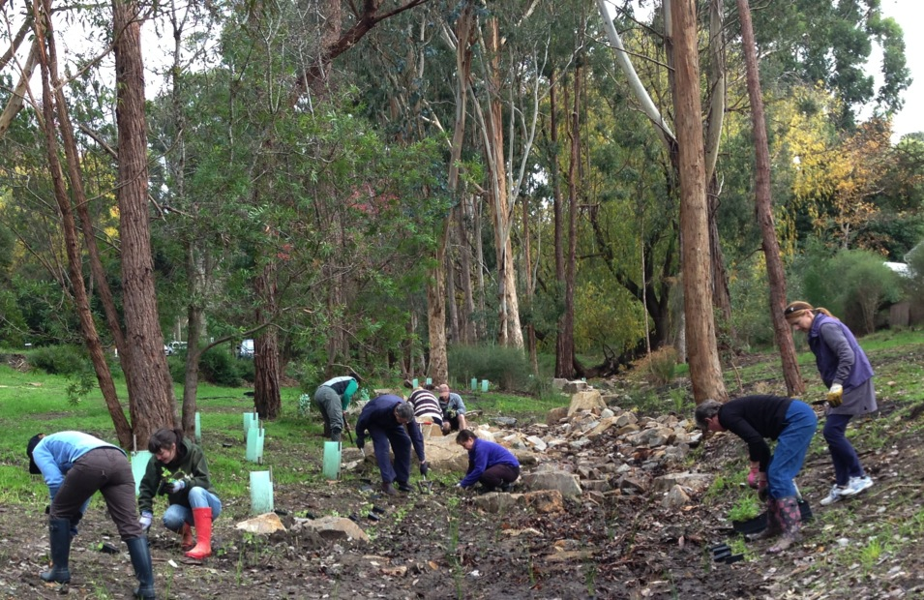
Revegetation
Weed control
Salinity program
Soils program
Watercourse management
Property Management Planning
Notes:
Main activities of Landcare Groups through Decade of Landcare.
Key achievements:
Eyre Peninsula: 60% uptake of property management planning course – highest in state and possibly region.
Kangaroo Island: fastest growth of Landcare groups in SA following introduction of Landcare movement. From 1989 – 2014: 3500km fencing to protect 28,000 hectares of remnant veg. 7,800 ha of works on perennial pasture.
AMLR: Strong community links between Landcare groups, schools, rotary groups and others, both urban and rural. Positive impact on long-term change of farmers’ knowledge and attitude to landcare. Farmers were able to come together to discuss similar issues and plan solutions. Restoration and revegetation around Bungala river (Yankalilla). Landcare’s schools program was very strong. Cape Jervis Progress Association’s work around headlands.

Slide 5
Challenges
…..and our greatest assets!
Landscapes & People

Slide 6
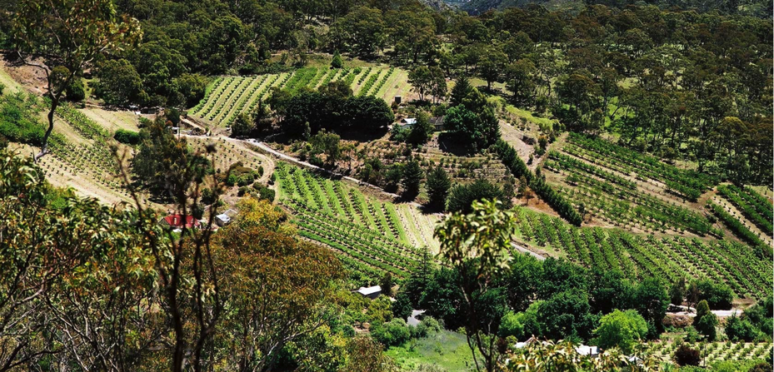
Regional NRM planning - landscape approach

Slide 7
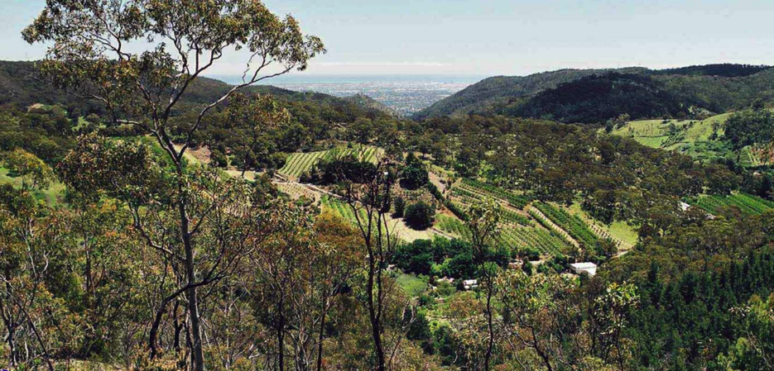
Regional NRM planning - landscape approach

Slide 8
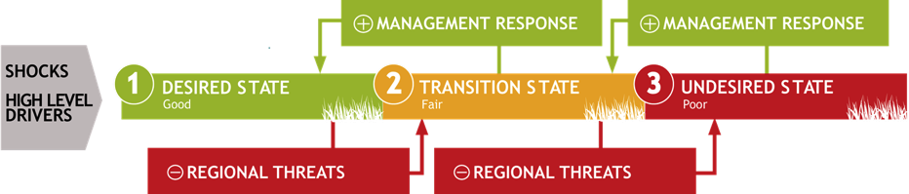
Regional NRM plan – conceptual models
Notes:
community support for natural resources management
building capacity of natural resources managers
sustainable primary production
adapting to a changing climate

Slide 9
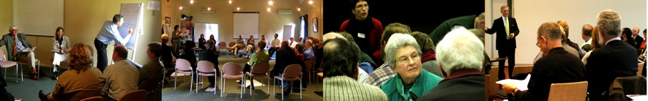
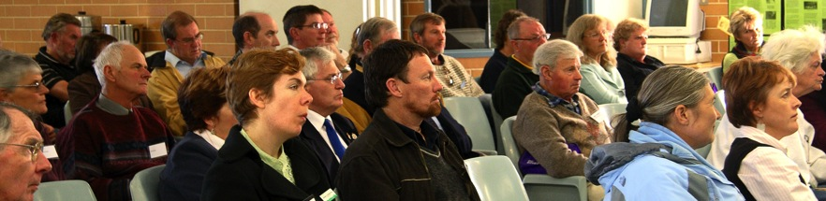
Who is in your community? - people

Slide 10
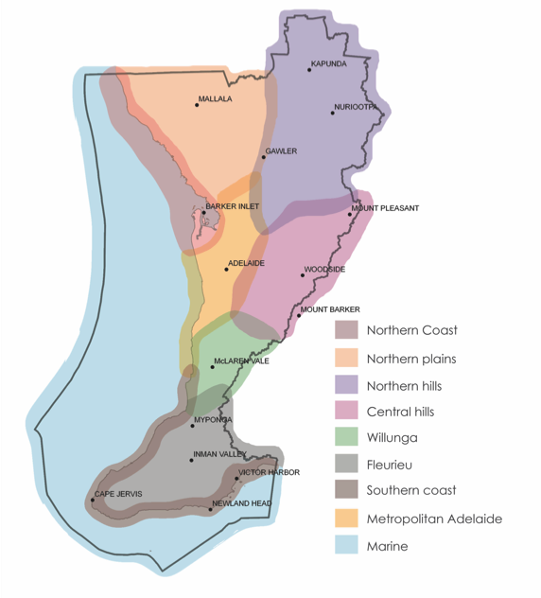

Slide 11
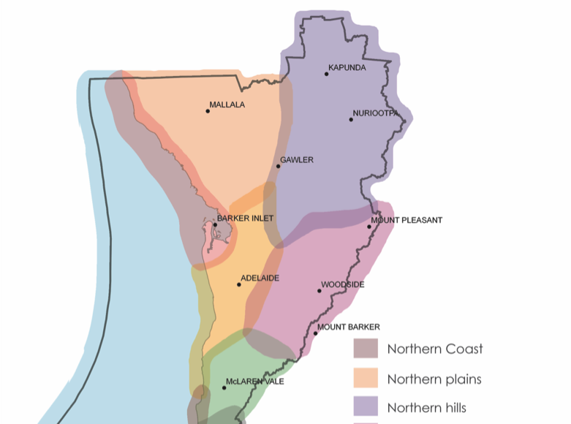

Slide 12
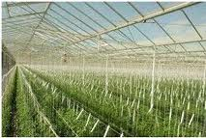
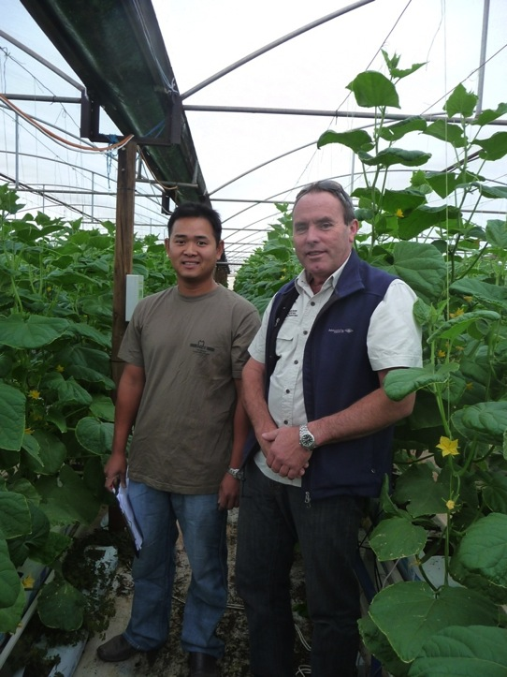
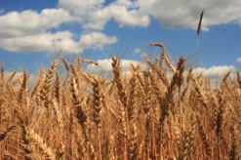
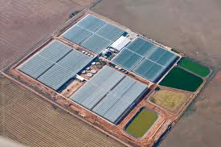
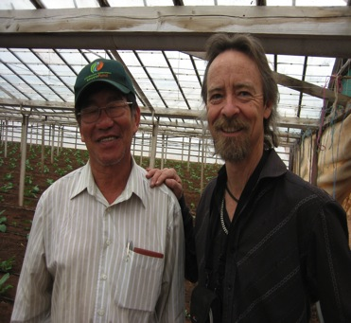

Slide 13
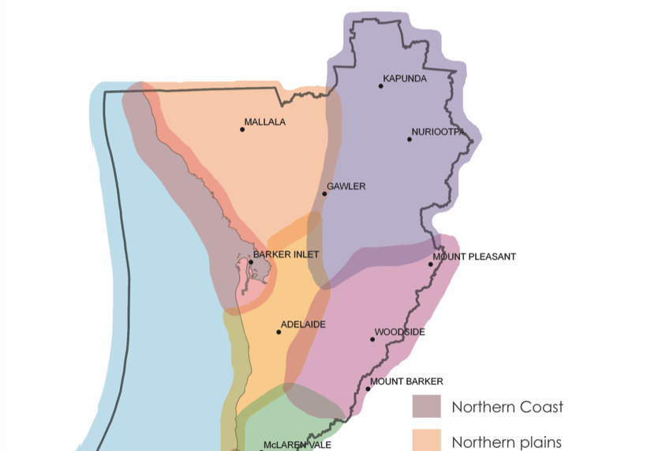

Slide 14
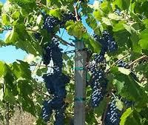
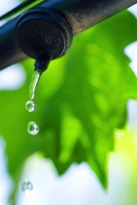
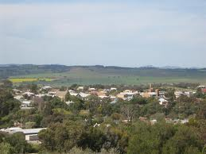
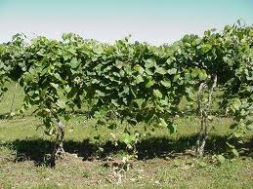
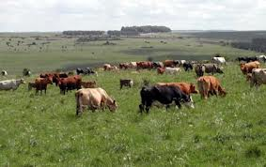
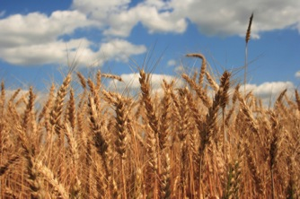
Barossa, grape vines,
Grazing, ag bureau,
soil testing with farm groups
Notes:
Barossa, grape vines,
Grazing, ag bureau,
soil testing with farm groups

Slide 15
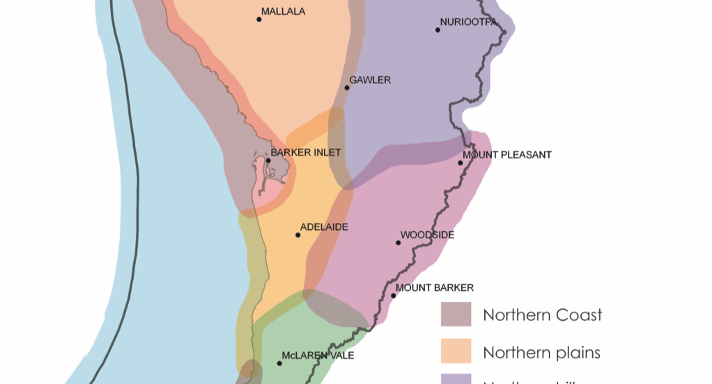

Slide 16
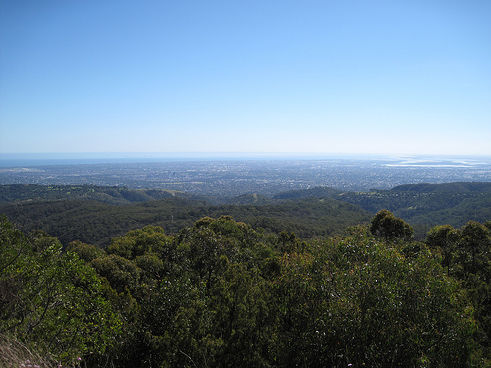
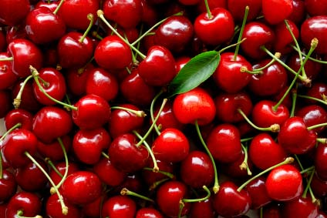
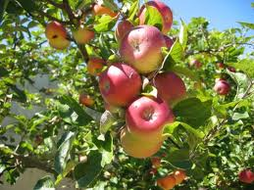
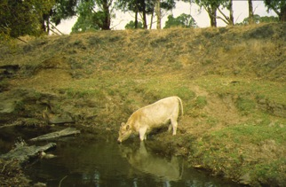
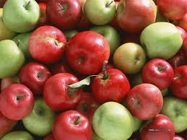
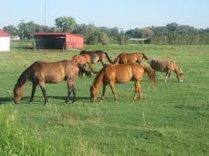
Central hills, cows, rolling hills, apples, cherries, horses
Notes:
Central hills, cows, rolling hills, apples, cherries, horses

Slide 17
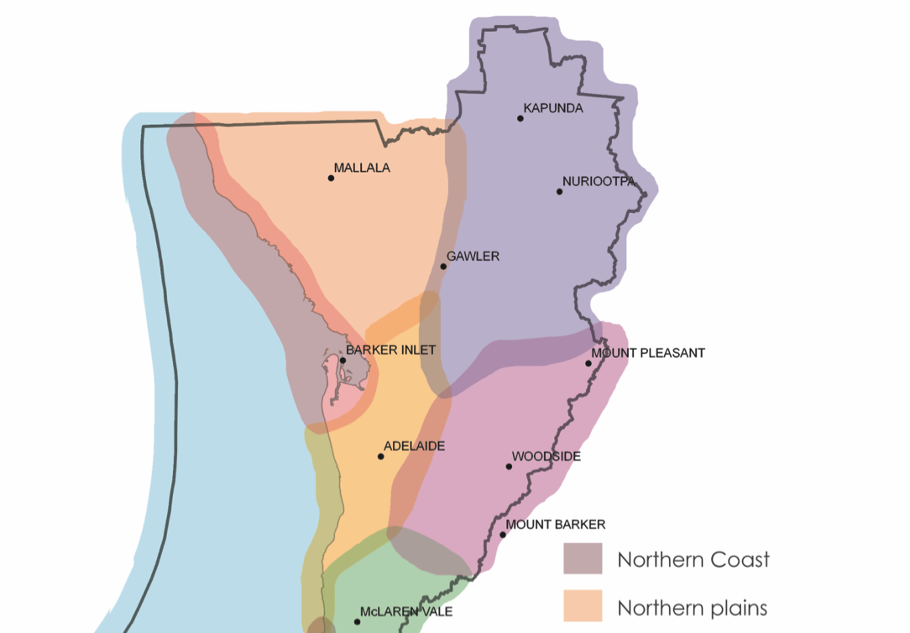

Slide 18
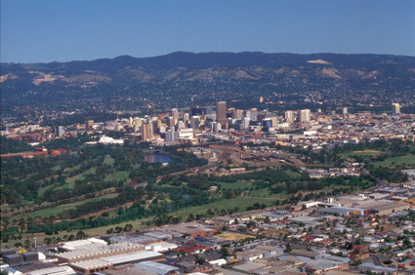
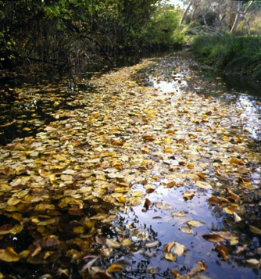
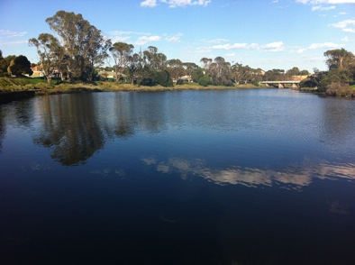
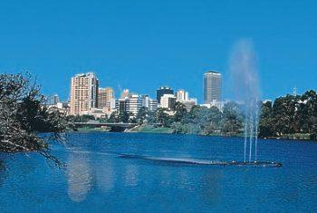
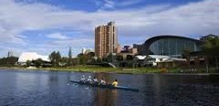
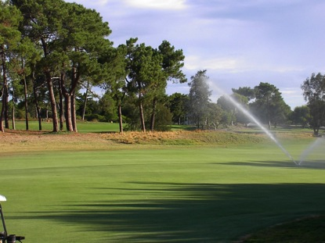
Urban, golf course, trash racks
Notes:
Urban, golf course, trash racks

Slide 19
The Premier’s Better Together Program
………… commenced in 2013 to enable the South Australian Government to make better decisions by bringing the voices of citizens and stakeholders into the issues that are relevant to them.

Slide 21
Regional NRM plan – conceptual models
Notes:
community support for natural resources management
building capacity of natural resources managers
sustainable primary production
adapting to a changing climate

Slide 22
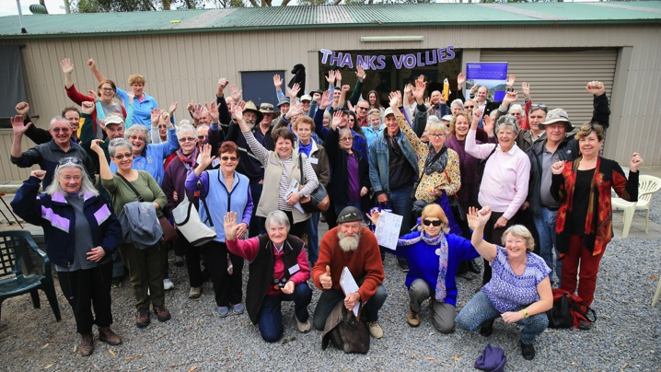
Community Connect
NRM regional plan
Better
Together
NRM Ed
AMLR NRM Community Action Grants
Notes:
AMLR NRM Plan
Regional targets over 20 years, iTargets over 5 years
13-14 Achievement report, Communities: 172 volunteers groups assisted (6318 volunteers, $4.7 million volunteers in-kind effort)
13-14 Achievement report: 6240 landholders supported to adopt sustainable management practices; property visits and technical advice to 1891 landholders; 363 landholders supported in protecting native habitat; 375 schools involved in NRM Ed-supported activities

Slide 23

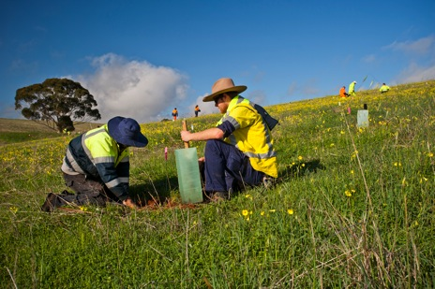


National Landcare Program
2014 – 2018
$1 billion over 4 years
4 Strategic Objectives
Notes:
Four Strategic objectives:
Communities are managing landscapes to sustain long-term economic and social benefits from their environment
Farmers and fishers are increasing their long term returns through better management of the natural resource base
Communities are involved in caring for their environment
Communities are protecting species and natural assets

Slide 24
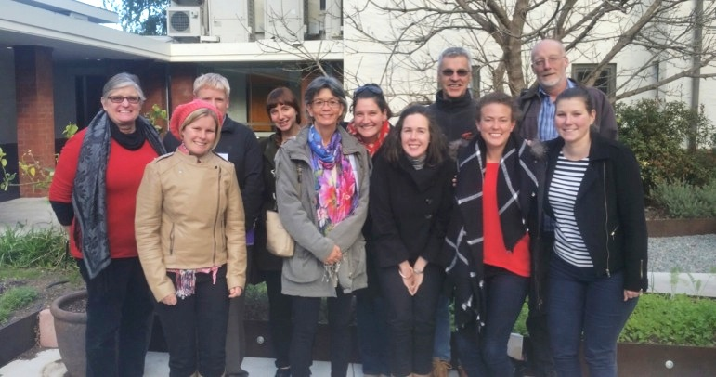
National Landcare Program
Green Army
RLF Program
20 Million Trees
Notes:
Regional Landcare Facilitator Program: In every NRM region across country – work with individual landholders, Landcare/community groups, industry groups, grower groups, ag bureaus. Focus on delivering education and training programs and funding projects that improve sustainable agriculture practices.
Green Army: encourages youth involvement in community groups (lack of young members is an issue). AMLR Green Army projects -
20 Million Trees: funding of reveg projects – opportunity for community members to have ownership and understanding of importance of landcare
National Landcare Program: Regional NRM organisations will continue to build on their partnerships with the Landcare community and will strengthen the capacity of the NRM community to care for their local environments.

Slide 25
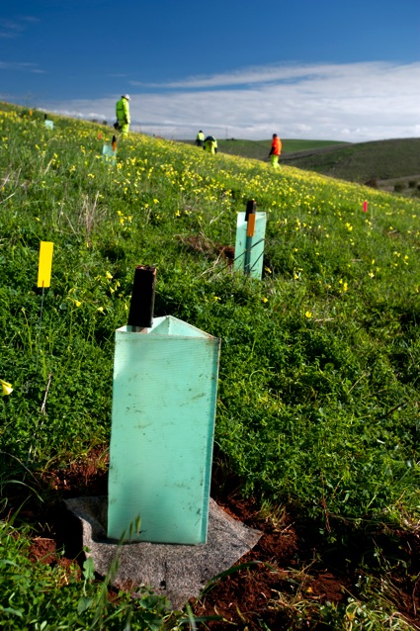
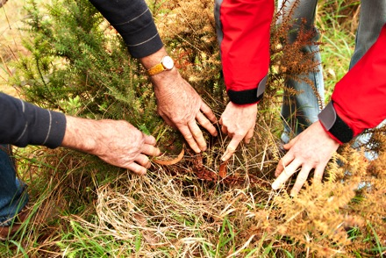
What next?
NLP ends in 2018
Better Together
Community Connect
Volunteer Support
Notes:
Government cannot discount importance of community involvement in NRM plan

